Slide 1
App center
week 1

Slide 2
Contents
01
02
Basic things of a server
Methods to develop a server

Slide 3
01
Basic things of a server
What is a server?
The overall picture of how it works

Slide 4

What is a server?
A server is a computer that provides a service to other programs called “clients”. -> What kind of computer can be a server?
A server is reached either via its IP address or Domain Name Servers(its role?)

Slide 5
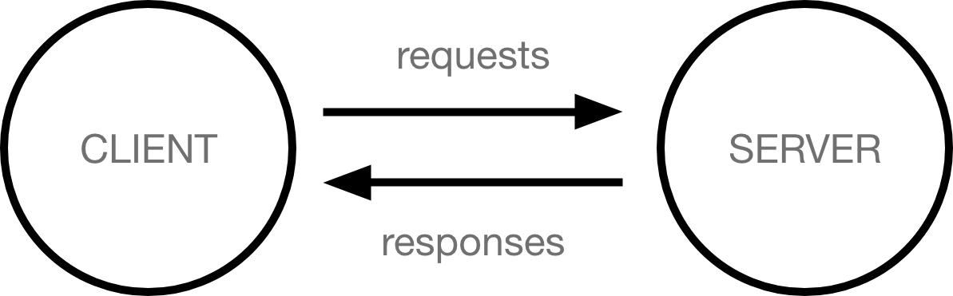
The structure of a server
Servers usually run unattended without input or output devices.
The dominant operating system among server is Linux with
Windows Server also having a significant share.
Client–server systems are most frequently
implemented by the request–response model.
How does this works?
This architecture is called the client–server model.

Slide 6
02
Frameworks to develop a server
Node.js(express)
Python(Django)
Java(Spring)
PHP(Laravel)

Slide 7
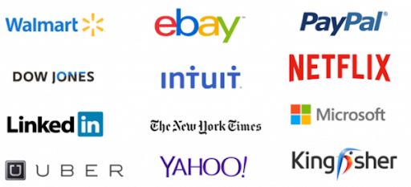
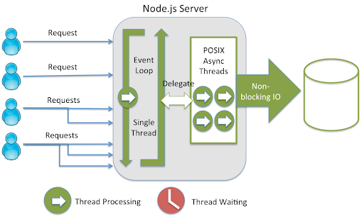
Node.js
Companies that use node.js
Netflix
Uber
LinkedIn
PayPal
Ebay
NASA
Features
Event-driven in a single thread event loop, which leads to fast speed
Convenience of full-stack development, because

Slide 8
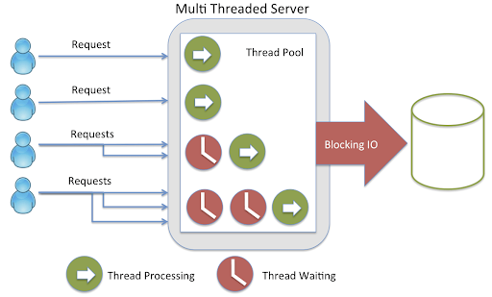
Spring
Companies that spring
Google
Microsoft
Naver
Amazon
Accenture
Intuit
Node.js VS Spring
A lot of I/O : go to Node.js
Fast computing : go to Spring
Features
multi-threading which makes intensive computing faster
due to I/O

Slide 9
Django
Companies that spring
Features
Excellent Documentation (one of the main reasons to use Django)
Rapid development (Like normal python development)
Instagram
Youtube
Dropbox
Mozilla
Spotify
Pinterest
Disqus
Bitbucket Eventbrite

